Slide 1
PROJECT OVERVIEW •
Enterprise Healthcare EHR Analytics Platform
BUSINESS INTELLIGENCE & INFORMATICS CAPSTONE
Optimizing Clinical Outcomes, Acute Hospital Flow, and Payer Economics
An interactive multi-stakeholder Power BI analytics platform architected to overcome fragmented hospital databases and deliver role-specific business intelligence for executive healthcare decision-makers.
• 5 Dedicated Executive Views: Role-tailored dashboards for CEO, CFO, CMO, COO, RCM, and Chief Population Health Officer.
• Advanced Methodological Depth: Normalized Star Schema, 35+ master DAX calculations, longitudinal 30-day readmissions, and statistical Z-scores.
• Measurable Business Value: Annual financial ROI through Transition Care Management, discharge pathways, and financial desks.
SYNTHEA ENTERPRISE EHR DATASET SPECIFICATIONS
Longitudinal Multi-Table Healthcare Repository
• Total Patient Cohort: 1,171 unique patients spanning complete multi-decade lifespans (108-year longitudinal history: 1912 to 2020).
• Clinical Encounter Density: 53,346 total encounters across 6 classes (Wellness, Ambulatory, Outpatient, Urgent Care, Emergency, Inpatient).
• Diagnoses & Comorbidity: 8,376 condition records standardized into 9 major medical specialties with Charlson comorbidity risk weights (1 to 6).
• Pharmacy & Dispenses: 42,989 medication dispenses categorized by RxNorm drug classes to track polypharmacy exposure (>=5 active drugs).
• Clinical Procedures: 34,981 procedures spanning management, diagnostics, and surgical interventions with procedural base costs.
• Payer & Facility Network: 10 major payer plans (Medicare, Medicaid, Commercial) and 1,120 provider facilities across 14 Massachusetts counties.
Data Model Architecture: 9 Normalized Tables with 1-to-Many Relational Integrity
ABBREVIATIONS & GLOSSARY: EHR = Electronic Health Record | BI = Business Intelligence | DAX = Data Analysis Expressions | Rx = Prescription / Medication | SDoH = Social Determinants of Health
Slide 1 / 10
ABBREVIATIONS & GLOSSARY: EHR = Electronic Health Record | BI = Business Intelligence | DAX = Data Analysis Expressions | Rx = Prescription / Medication | SDoH = Social Determinants of Health
Slide 1 / 10

Slide 2
BUSINESS & CLINICAL PROBLEM STATEMENT
The Healthcare Triple Aim Dilemma & Institutional Challenges
1. CLINICAL QUALITY & CMS PENALTIES
26.50% Readmissions
(487 of 1,838 Inpatient Stays)
• Regulatory Threat: Under CMS HRRP guidelines, 30-day preventable readmissions exceeding 20% trigger penalties up to 3% of total Medicare reimbursements.
• Chronic Disease Driver: Heart failure, diabetes, and respiratory conditions in senior cohorts (age 65+) account for over 65% of preventable readmissions.
• Polypharmacy Risk: 41.0% of elderly chronic patients take >=5 concurrent medications, escalating adverse drug event risks.
2. ACUTE BED BOTTLENECKS & FLOW
18.04 Days Inpatient Stay
(33,160 Total Bed-Days Occupied)
• Capacity Saturation: Extended stay duration holds acute beds occupied, resulting in emergency room boarding and delayed surgical admissions.
• Outlier Variance: Statistical anomalies (Z > 2.0) in complex chronic cases drive unpredictable bed hold times without clinical pathway standardization.
• ED Triage Efficiency: Emergency conversion to inpatient is controlled at 2.34%, proving admissions originate from acute clinical necessity.
3. PAYER UNDER-REIMBURSEMENT
$3.56M Patient OOP Debt
(51.84% Total Financial Burden)
• Payer Recovery Gap: Insurers recover only 48.16% ($3.31M) of $6.87M gross billed claims, leaving a $3.56M uncollected shortfall.
• Uninsured Vulnerability: Uninsured patients face >$1.3M in direct liabilities, representing the primary driver of hospital uncompensated bad debt.
• Managed Care Disparities: Significant variance between commercial yields (45%–65%) and government payment formulas.
3. PAYER UNDER-REIMBURSEMENT
$3.56M Patient OOP Debt
(51.84% Total Financial Burden)
• Payer Recovery Gap: Insurers recover only 48.16% ($3.31M) of $6.87M gross billed claims, leaving a $3.56M uncollected shortfall.
• Uninsured Vulnerability: Uninsured patients face >$1.3M in direct liabilities, representing the primary driver of hospital uncompensated bad debt.
• Managed Care Disparities: Significant variance between commercial yields (45%–65%) and government payment formulas.
ABBREVIATIONS & GLOSSARY: CMS = Centers for Medicare & Medicaid Services | HRRP = Hospital Readmissions Reduction Program | ALOS = Average Length of Stay | OOP = Out-of-Pocket | ED = Emergency Department | RCM = Revenue Cycle Management
Slide 2 / 10
ABBREVIATIONS & GLOSSARY: CMS = Centers for Medicare & Medicaid Services | HRRP = Hospital Readmissions Reduction Program | ALOS = Average Length of Stay | OOP = Out-of-Pocket | ED = Emergency Department | RCM = Revenue Cycle Management
Slide 2 / 10

Slide 3
RELATIONAL MODELING & ADVANCED ANALYTICS ARCHITECTURE
Production Star Schema Architecture & Master DAX Calculation Engine
9-TABLE STAR SCHEMA ARCHITECTURE (1:* RELATIONS)
Normalized Relational Data Model
• Dim_Patients (1,171 Rows): Central patient dimension with demographics, geographic attributes (county, zip, coordinates), and lifetime spend.
• Dim_Date (39,813 Rows): Master continuous calendar (1912–2020) enabling 100% precise time intelligence (YoY, MoM, and 90-day rolling rates).
• Fact_Encounters (53,346 Rows): Primary transaction fact linking patients, facilities, providers, payers, dates, and financial metrics.
• Clinical Sub-Facts: Fact_Conditions (8,376 diagnoses), Fact_Medications (42,989 dispenses), and Fact_Procedures (34,981 procedures).
• Supporting Dimensions: Dim_Organizations (1,120 facilities), Dim_Providers (1,104 physicians), and Dim_Payers (10 insurance plans).
✓ Star Schema Advantage: 100% normalized 1-to-many filter propagation eliminates Cartesian product duplication and guarantees sub-second query execution.
MASTER DAX CALCULATION ENGINE (35+ MEASURES)
Key Mathematical & Clinical Algorithms
1. Longitudinal 30-Day Readmission Window:
Sequenced encounters chronologically by patient key to evaluate consecutive Inpatient stays.
2. Charlson Comorbidity Burden Index (CCI):
Dynamic weighted clinical risk algorithm assigning validated scores (1 to 6) across cardiovascular, diabetic, renal, and oncological chronic conditions.
3. Statistical Length of Stay Z-Score Anomaly:
Formulated Z = (LOS - Mean) / StdDev to isolate inpatient stays exceeding 2 standard deviations (Z > 2.0) directly in visual tooltips.
4. Pareto 80/20 High-Utilizer Spend Deciles:
Iterates virtual patient tables using TOPN and SUMX to evaluate healthcare wealth and cost concentration curves across demographic cohorts.
ABBREVIATIONS & GLOSSARY: PK = Primary Key | FK = Foreign Key | CCI = Charlson Comorbidity Index | ALOS = Average Length of Stay | DAX = Data Analysis Expressions | VertiPaq = Power BI Analytics Engine
Slide 3 / 10
ABBREVIATIONS & GLOSSARY: PK = Primary Key | FK = Foreign Key | CCI = Charlson Comorbidity Index | ALOS = Average Length of Stay | DAX = Data Analysis Expressions | VertiPaq = Power BI Analytics Engine
Slide 3 / 10

Slide 4
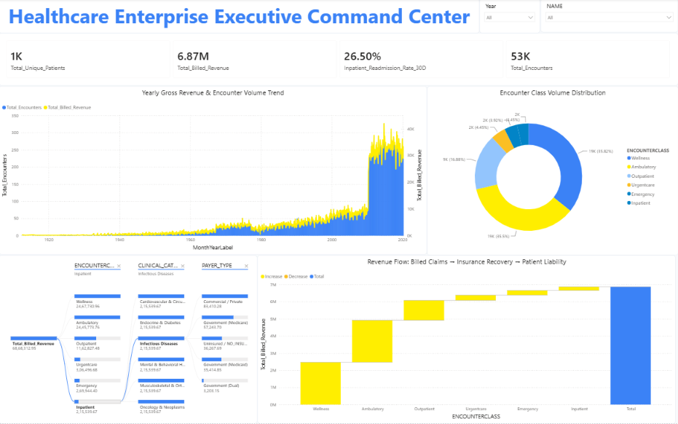
C-SUITE LEADERSHIP • CEO & CFO GOVERNANCE PERSONA
Dashboard 1: C-Suite Executive Command Center
C-SUITE REVENUE VELOCITY & GOVERNANCE
Key Executive & Clinical Findings
• Gross Billed Claims: $6,868,312.95
(53,346 Encounters across 1,171 Patients)
• Readmission Rate: 26.50%
• Macro Governance: Gives executive leadership immediate visibility into gross revenue trajectory, patient volume growth, and clinical readmission risk.
• Revenue Waterfall Dynamics: This demonstrates that while inpatient care drives our clinical risk and bed occupancy, our top-line revenue volume is heavily anchored in outpatient and ambulatory services.
• Decomposition Tree Root-Cause: Enables drill-down of billed revenue across Encounter Classes (Wellness vs Inpatient), Clinical Categories, and Payer Types.
• Strategic Takeaway: 51.84% patient financial liability represents significant exposure to bad-debt write-offs without proactive financial counseling.
ABBREVIATIONS & GLOSSARY: CEO = Chief Executive Officer | CFO = Chief Financial Officer | OOP = Out-of-Pocket | RCM = Revenue Cycle Management | YoY = Year-Over-Year | MoM = Month-Over-Month
Slide 4 / 10
ABBREVIATIONS & GLOSSARY: CEO = Chief Executive Officer | CFO = Chief Financial Officer | OOP = Out-of-Pocket | RCM = Revenue Cycle Management | YoY = Year-Over-Year | MoM = Month-Over-Month
Slide 4 / 10

Slide 5
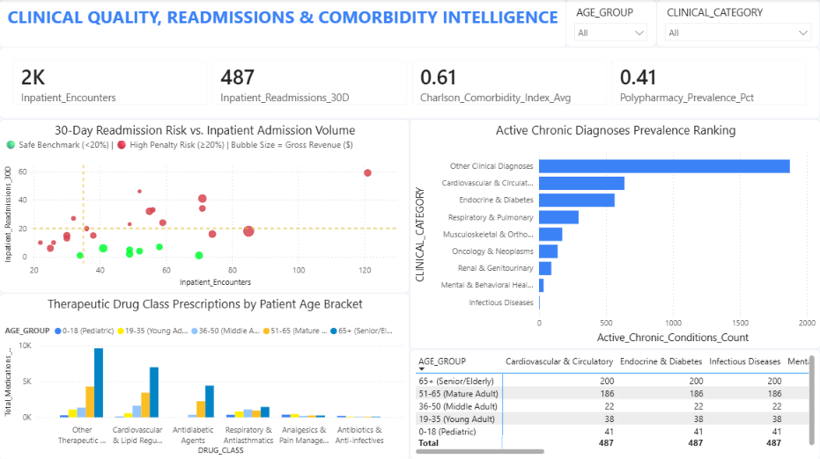
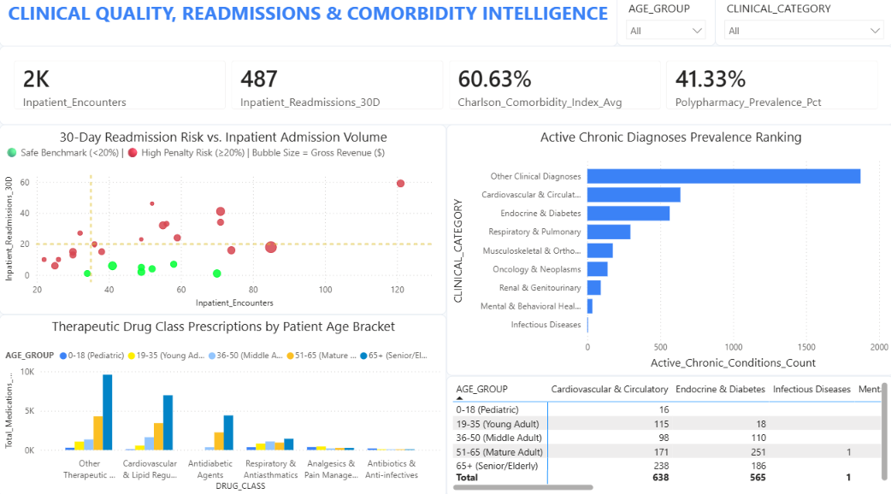
CLINICAL QUALITY BOARD • CHIEF MEDICAL OFFICER (CMO) PERSONA
Dashboard 2: Clinical Quality & Comorbidity Intelligence
30-DAY READMISSIONS & CLINICAL RISK STRATIFICATION
Key Executive & Clinical Findings
• Inpatient 30D Return: 487 Readmissions
(26.50% Rate (Target: < 20.00%))
• Polypharmacy Rate: 41.0% Cohort
(>= 5 Concurrent Active Rx Dispenses)
• Readmission 4-Quadrant Matrix: Pinpoints clinical specialties in the high-volume, high-penalty quadrant exceeding the 20% CMS penalty threshold.
• Chronic Disease Clustering: Cardiovascular & Circulatory (638) and Endocrine & Diabetes represent over 65% of all active chronic disease diagnoses.
• Senior Comorbidity & Polypharmacy: Seniors (65+) carry 238 cardiac and 186 diabetic diagnoses, driving severe polypharmacy (>=5 Rx) and 200 inpatient readmissions.
• Strategic Clinical Protocol: Deploying Transition Care Management (TCM) 48-hr nurse follow-ups for patients with Charlson Index >= 3 targets a 20% readmission reduction.
ABBREVIATIONS & GLOSSARY: CMO = Chief Medical Officer | HRRP = Hospital Readmissions Reduction Program | CCI = Charlson Comorbidity Index | Rx = Prescription / Drug | TCM = Transition Care Management
Slide 5 / 10
ABBREVIATIONS & GLOSSARY: CMO = Chief Medical Officer | HRRP = Hospital Readmissions Reduction Program | CCI = Charlson Comorbidity Index | Rx = Prescription / Drug | TCM = Transition Care Management
Slide 5 / 10

Slide 6
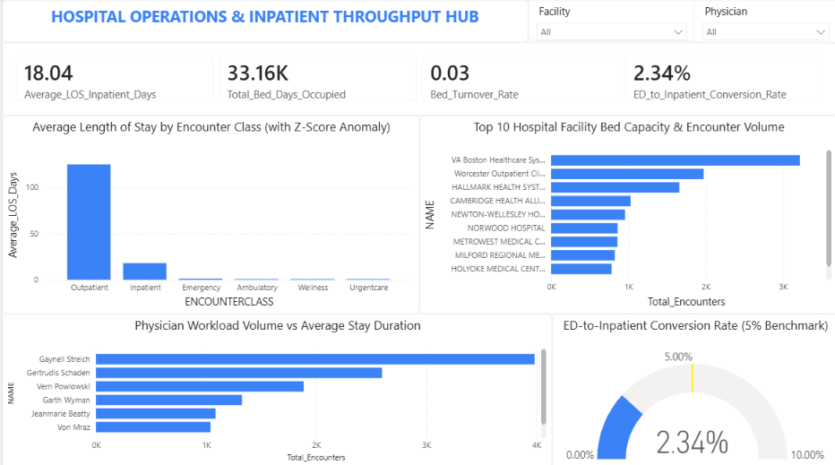
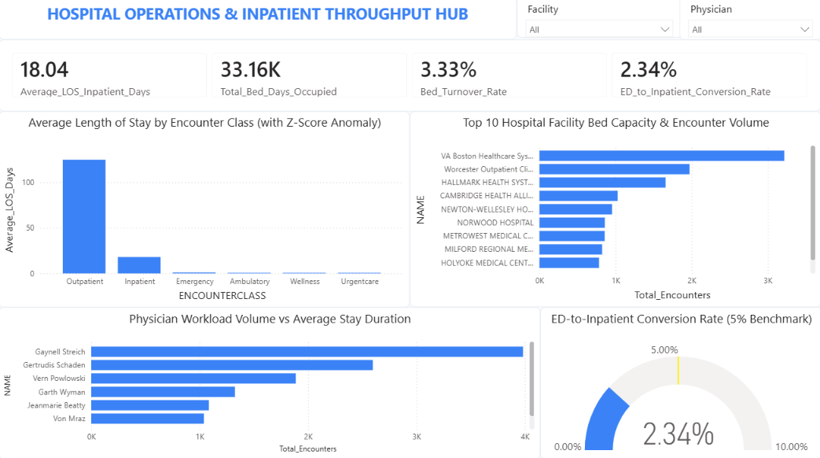
HOSPITAL OPERATIONS • CHIEF OPERATING OFFICER (COO) PERSONA
Dashboard 3: Hospital Operations & Inpatient Throughput Hub
ACUTE BED CAPACITY & DISCHARGE FLOW
Key Executive & Clinical Findings
• Inpatient ALOS: 18.04 Days
(33,160 Total Bed-Days Occupied)
• ED-to-Inpatient Rate: 2.34% Conversion
(49 / 2,090 Visits (Benchmark: < 5.0%))
• Inpatient Stay Duration: Average stay of 18.04 days represents an acute operational opportunity to eliminate discharge bottlenecks.
• Emergency Triage Velocity: A 2.34% ED-to-inpatient conversion rate confirms excellent emergency room triage, resolving non-emergent visits without clogging inpatient beds.
• Physician & Facility Throughput: Tracks patient volume vs stay duration across 1,120 facilities (VA Boston, Worcester) and attending physicians.
• Strategic Operational Protocol: Standardized clinical discharge rounds can reduce stay duration by 2.5 days, freeing 4,500 bed-days (+15% acute capacity).
ABBREVIATIONS & GLOSSARY: COO = Chief Operating Officer | ALOS = Average Length of Stay | ED = Emergency Department | LOS = Length of Stay | VA = Veterans Affairs | Z-Score = Standard Deviation Anomaly
Slide 6 / 10
ABBREVIATIONS & GLOSSARY: COO = Chief Operating Officer | ALOS = Average Length of Stay | ED = Emergency Department | LOS = Length of Stay | VA = Veterans Affairs | Z-Score = Standard Deviation Anomaly
Slide 6 / 10

Slide 7
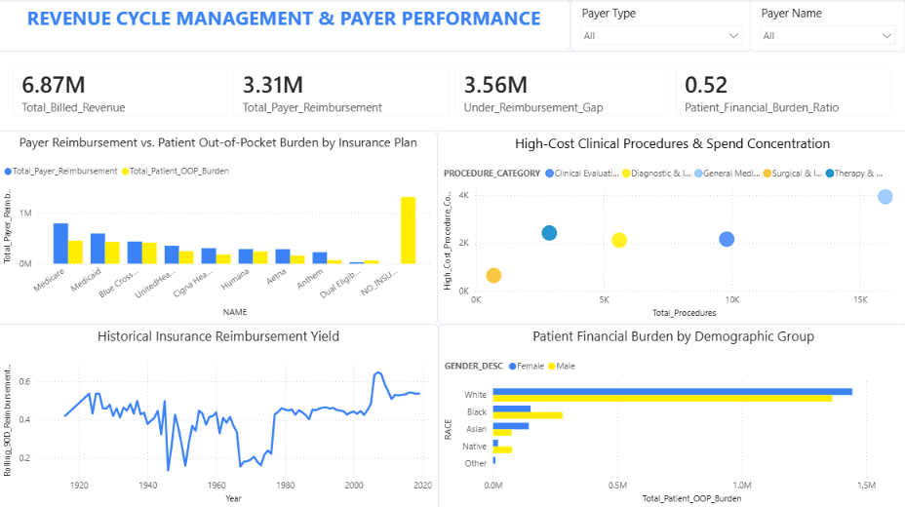
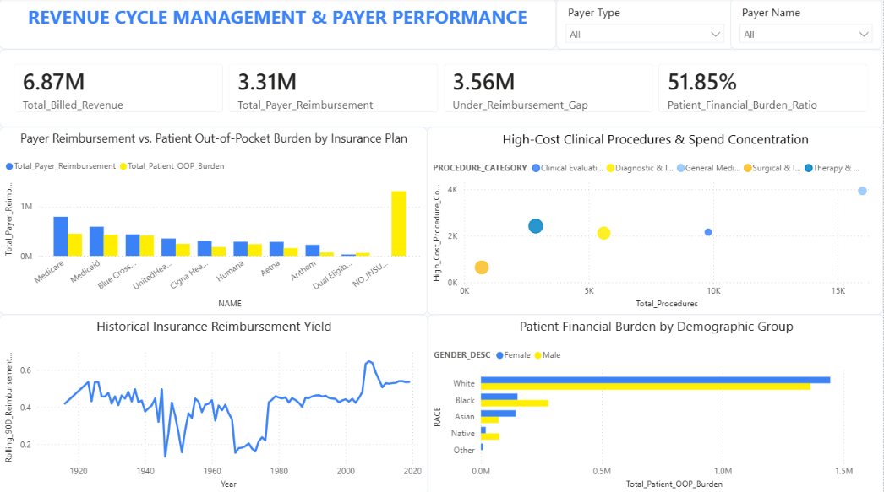
MANAGED CARE RELATIONS • VP OF REVENUE CYCLE (RCM) PERSONA
Dashboard 4: Revenue Cycle Management & Payer Performance
PAYER RECOVERY & PATIENT DEBT LIABILITY
Key Executive & Clinical Findings
• Under-Reimbursement: $3,560,921.38
(51.84% Uncollected Insurance Shortfall)
• Uninsured Patient Debt: $1.30M+ Exposure
(NO_INSURANCE Plan Liability)
• Payer Contract Under-Reimbursement: Reveals significant variance in reimbursement ratios between commercial payers (45%–65%) and government plans.
• Uninsured Bad-Debt Driver: Patients without insurance coverage account for over $1.3M in direct liabilities, driving hospital uncompensated care.
• Surgical cases average the highest unit cost ($14,625 vs $3,106 general care), with 236 out of 299 operations exceeding the $5,000 high-cost threshold.
• Strategic Financial Protocol: Upfront financial counseling desks and prior authorization reviews accelerate cash collection by 14 days and cut bad debt by $150,000/year.
ABBREVIATIONS & GLOSSARY: RCM = Revenue Cycle Management | OOP = Out-of-Pocket | MA = Massachusetts | Commercial = Private Health Insurers | Medicare = Federal Elder Insurance | Medicaid = State Assistance
Slide 7 / 10
ABBREVIATIONS & GLOSSARY: RCM = Revenue Cycle Management | OOP = Out-of-Pocket | MA = Massachusetts | Commercial = Private Health Insurers | Medicare = Federal Elder Insurance | Medicaid = State Assistance
Slide 7 / 10

Slide 8
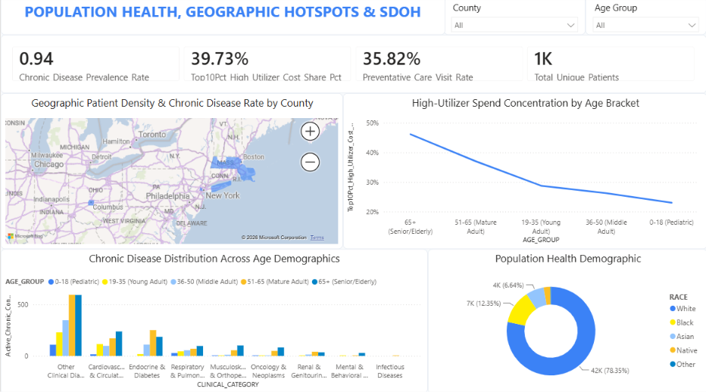
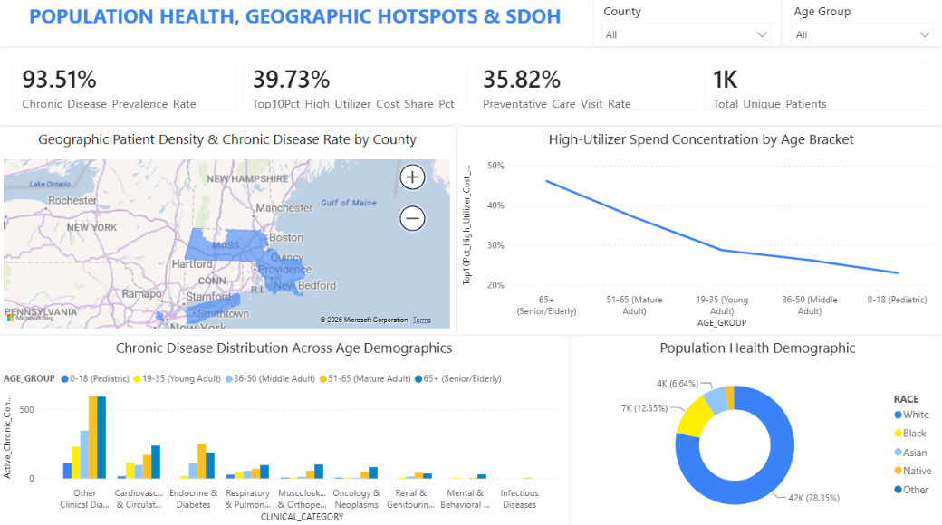
EPIDEMIOLOGY & COMMUNITY CARE • CHIEF POPHEALTH OFFICER PERSONA
Dashboard 5: Population Health, Geographic Hotspots & SDoH
GEOGRAPHIC DENSITY & SDOH HEALTH EQUITY
Key Executive & Clinical Findings
• Chronic Prevalence: 94.0% Cohort
(Diagnosed with >= 1 Chronic Condition)
• Top 10% High Utilizers: 39.73% Spend
(Pareto 80/20 Cost Concentration)
• Geographic Disease Clustering: Middlesex and Worcester counties represent over 34% of the aggregate chronic disease burden across Massachusetts.
• Age Demographics & Chronic Burden: High-utilizer spend concentration accelerates above age 51, while pediatric cohorts present predominantly with asthma.
• SDoH Health Equity Donut: Quantifies patient demographic equity across racial and ethnic groups to identify vulnerable populations.
• Strategic PopHealth Protocol: Preventative wellness visit adherence is 35.82%, highlighting an opportunity to deploy mobile clinics and community health workers.
ABBREVIATIONS & GLOSSARY: PopHealth = Population Health | SDoH = Social Determinants of Health | GIS = Geographic Information System | Pareto = 80/20 Cost Concentration Curve | RxNorm = National Drug Code Standard
Slide 8 / 10
ABBREVIATIONS & GLOSSARY: PopHealth = Population Health | SDoH = Social Determinants of Health | GIS = Geographic Information System | Pareto = 80/20 Cost Concentration Curve | RxNorm = National Drug Code Standard
Slide 8 / 10

Slide 9
CLINICAL ACTION PLAN & FINANCIAL IMPACT MODEL
Strategic Clinical Protocols & Quantified Financial ROI ($430,000+ Net Annual Savings)
1. TRANSITION CARE MANAGEMENT
+$280,000 / Year
CMS Penalty Avoidance & Recovery
• Clinical Protocol: Introduce mandatory 48-hour post-discharge nurse follow-up calls and 7-day primary clinic visits for high-risk patients (Charlson Comorbidity Index >= 3).
• Target Clinical Impact: Reduces 30-day preventable readmissions from 26.50% to under 21.0% across chronic cardiovascular and diabetic cohorts.
• Quantified Value: A 20% reduction in preventable 30-day readmissions avoids ~$280,000 in CMS penalty deductions and uncompensated care expenses.
2. DISCHARGE CARE PATHWAYS
+4,500 Bed-Days
+15% Acute Intake Capacity
• Action Protocol: Institute standardized multidisciplinary daily discharge planning rounds across surgical and acute inpatient wards.
• Target Outcome: Decreasing average stay from 18.04 to 15.5 days frees 4,500 acute bed-days, increasing high-margin surgical intake capacity without expanding physical hospital beds.
3. FINANCIAL COUNSELING DESK
+$150,000 / Year
Bad-Debt Mitigation & Velocity
• Financial Protocol: Implement point-of-entry financial advocacy to screen uninsured patients and enroll eligible individuals into Medicaid or health exchange plans prior to discharge.
• Target Clinical Impact: Converts uncompensated medical debt exposure ($1.30M+ NO_INSURANCE liability) into formal reimbursed claims with pre-approved payment schedules.
• Quantified Value: Accelerates cash collection velocity by 14 days and directly lowers uncompensated bad-debt write-offs by $150,000 annually.
TOTAL INSTITUTIONAL NET ROI: $430,000+ ANNUALLY + 4,500 ACUTE BED-DAYS UNLOCKED
Implementing these three targeted protocols closes the hospital operational throughput and financial leakage loop: avoiding CMS quality penalties ($280,000), increasing surgical intake capacity (+15%), and converting uncompensated patient medical debt into active payer recoveries ($150,000).
TOTAL INSTITUTIONAL NET ROI: $430,000+ ANNUALLY + 4,500 ACUTE BED-DAYS UNLOCKED
Implementing these three targeted protocols closes the hospital operational throughput and financial leakage loop: avoiding CMS quality penalties ($280,000), increasing surgical intake capacity (+15%), and converting uncompensated patient medical debt into active payer recoveries ($150,000).
ABBREVIATIONS & GLOSSARY: ROI = Return on Investment | TCM = Transition Care Management | CMS = Centers for Medicare & Medicaid Services | CCI = Charlson Comorbidity Index | ALOS = Average Length of Stay
Slide 9 / 10
ABBREVIATIONS & GLOSSARY: ROI = Return on Investment | TCM = Transition Care Management | CMS = Centers for Medicare & Medicaid Services | CCI = Charlson Comorbidity Index | ALOS = Average Length of Stay
Slide 9 / 10

